Slide 1
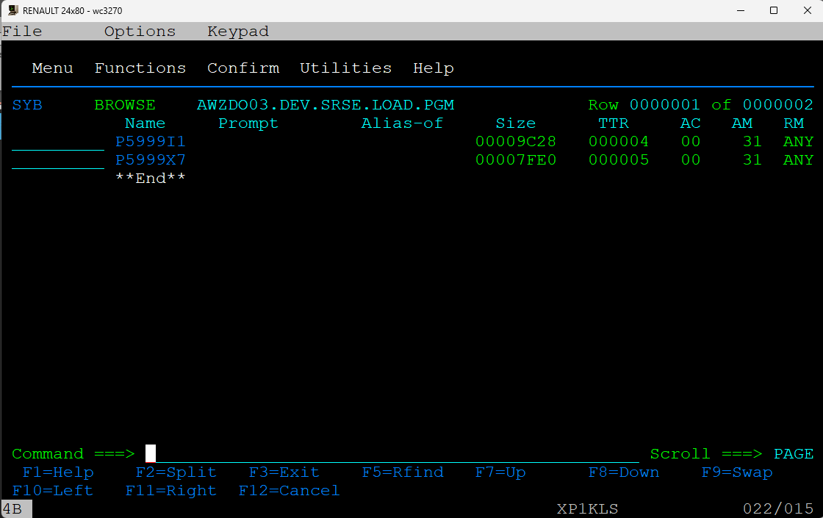
#1 - Getting load (P5999X7)

Slide 2
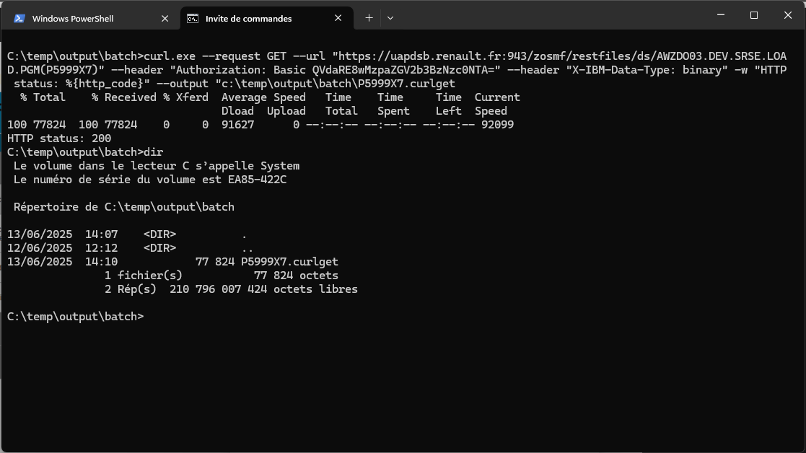
#2 – Curl get in a windows CMD
curl.exe --request GET --url "https://uapdsb.renault.fr:943/zosmf/restfiles/ds/AWZDO03.DEV.SRSE.LOAD.PGM(P5999X7)" --header "Authorization: Basic QVdaRE8wMzpaZGV2b3BzNzc0NTA=" --header "X-IBM-Data-Type: binary" -w "HTTP status: %{http_code}" --output "c:\temp\output\batch\P5999X7.curlget

Slide 3
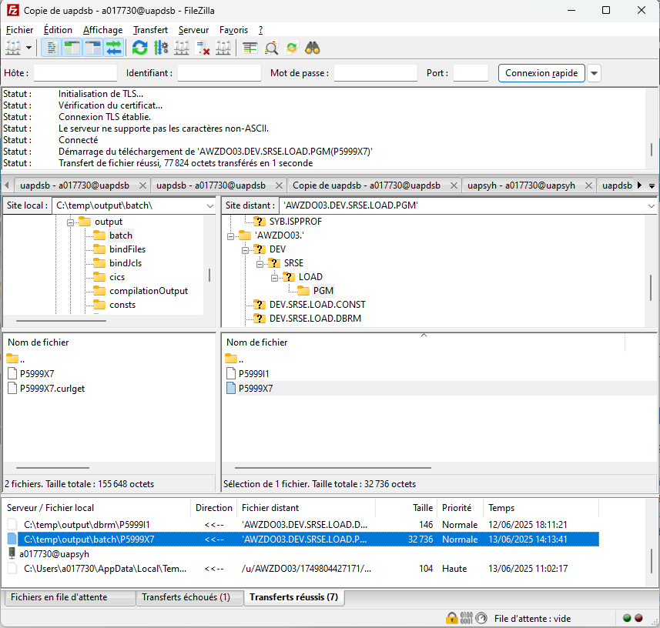
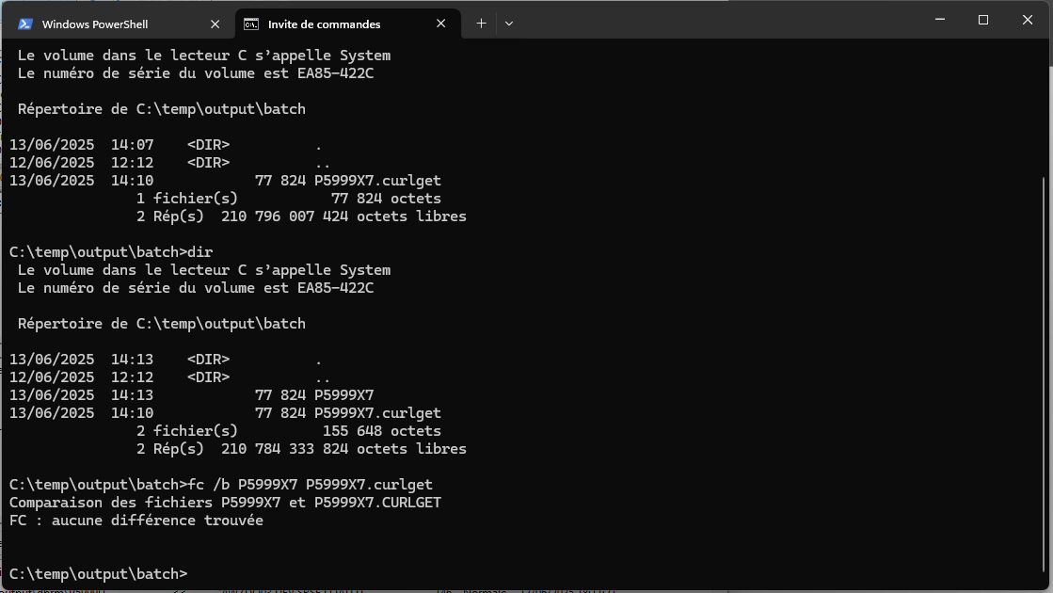
#3 – Getting file with Filezilla bin mode
No diff between FTP and ZOSMF API

Slide 4
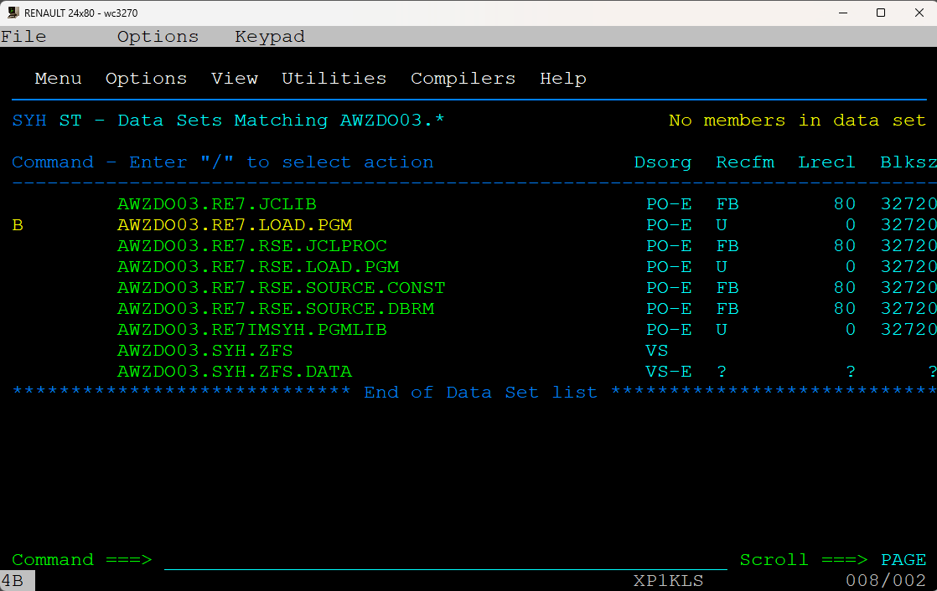
#4 – Create a emptyPDSE dataset to send the LOAD
C:\temp\output\batch>curl.exe --request POST --url "https://uaprca.renault.fr:943/zosmf/restfiles/ds/AWZDO03.RE7.LOAD.PGM" --header "Authorization: Basic QVdaRE8wMzpaZGV2b3BzNzc0NTA=" --header "content-type: application/json" --data "{ \"alcunit\": \"CYL\", \"primary\": 1, \"secondary\": 1, \"dsorg\": \"PO\", \"recfm\": \"U\", \"blksize\": 32720, \"dsntype\" : \"LIBRARY\" }" -w "HTTP status: %{http_code}"
HTTP status: 201
The new DataSet and SYH AWZDO3.RE7.LOAD.PGM is empty and has the good attributes

Slide 5
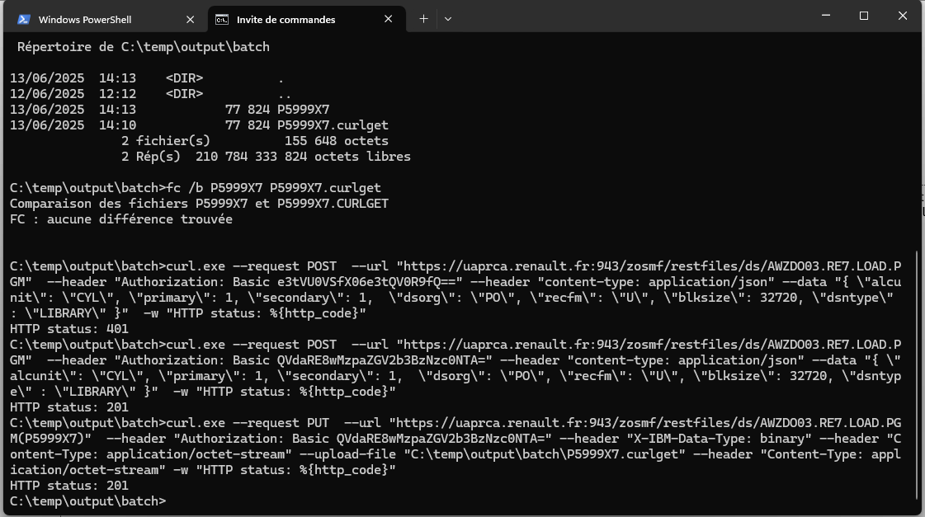
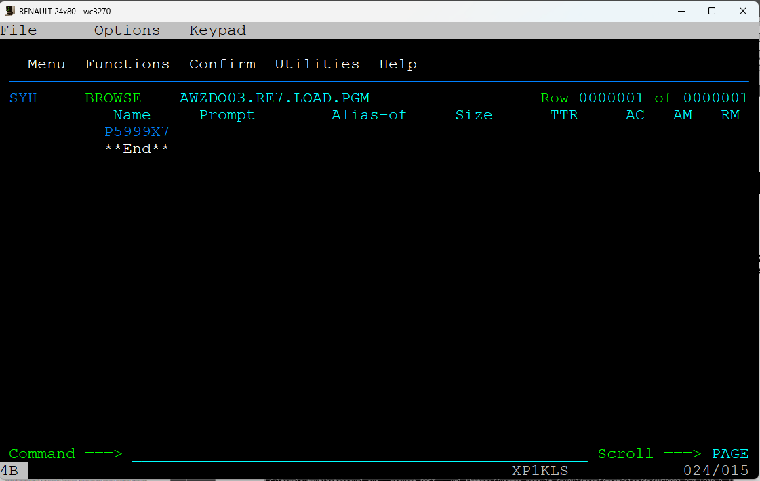
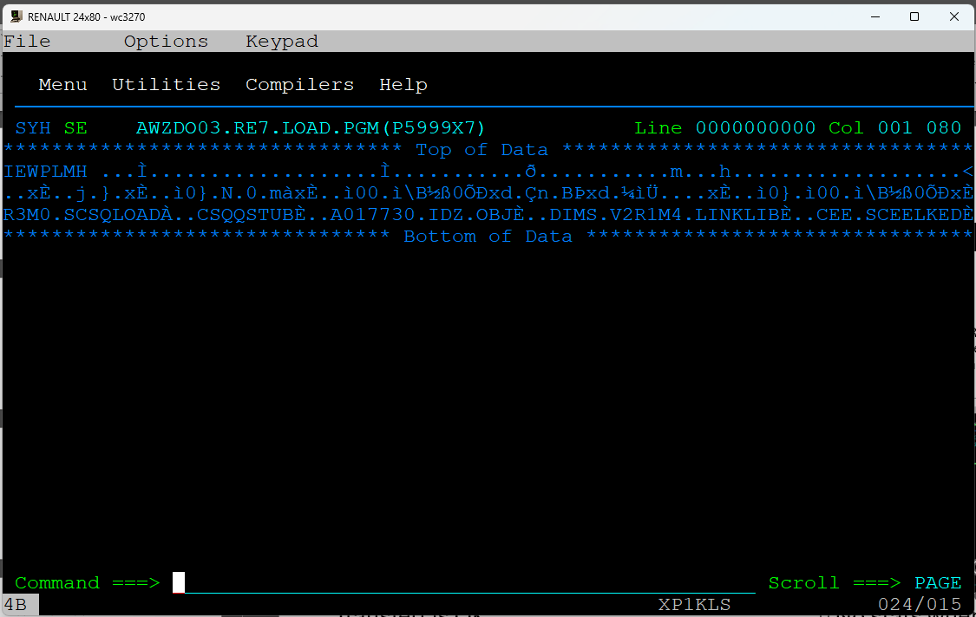
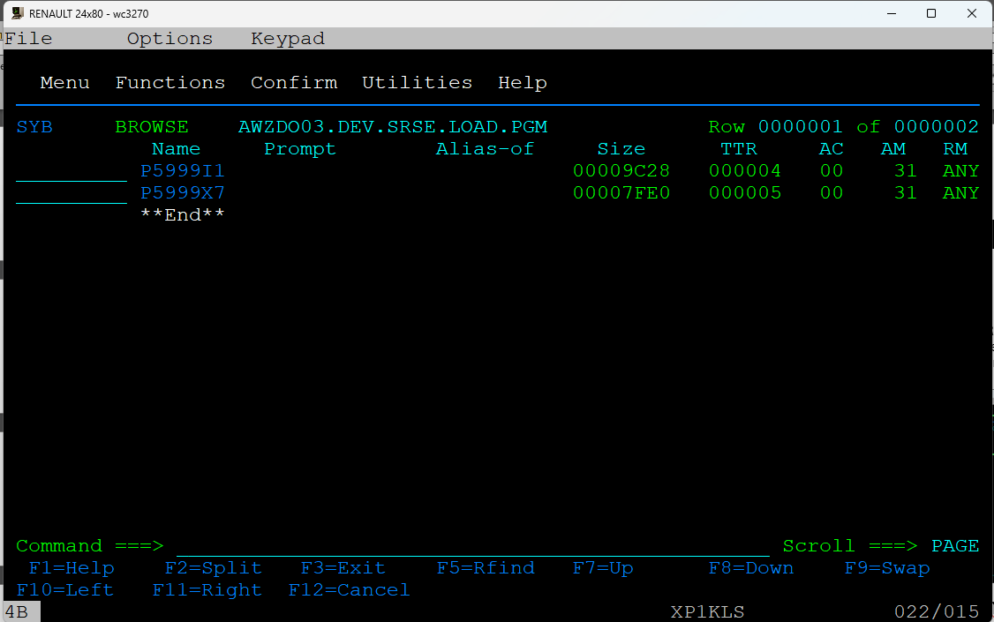
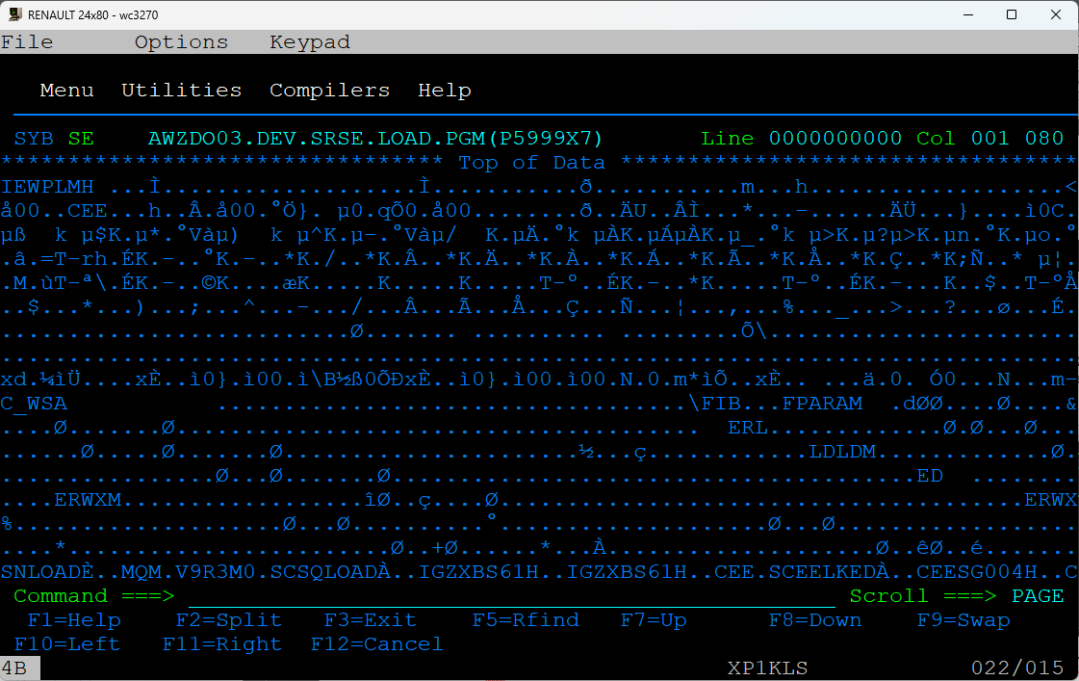
#5 – Send the load in bin mode
curl.exe --request PUT --url "https://uaprca.renault.fr:943/zosmf/restfiles/ds/AWZDO03.RE7.LOAD.PGM(P5999X7)" --header "Authorization: Basic QVdaRE8wMzpaZGV2b3BzNzc0NTA=" --header "X-IBM-Data-Type: binary" --header "Content-Type: application/octet-stream" --upload-file "C:\temp\output\batch\P5999X7.curlget" --header "Content-Type: application/octet-stream" -w "HTTP status: %{http_code}“
Transfert is OK
No stats when browsing
STATS on source system SYB ->

Slide 6
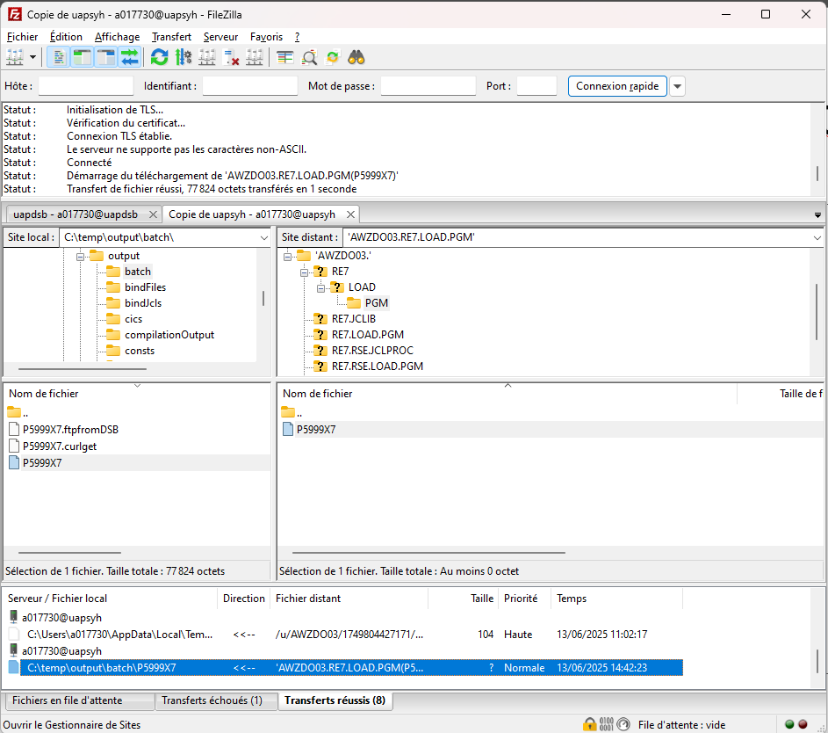
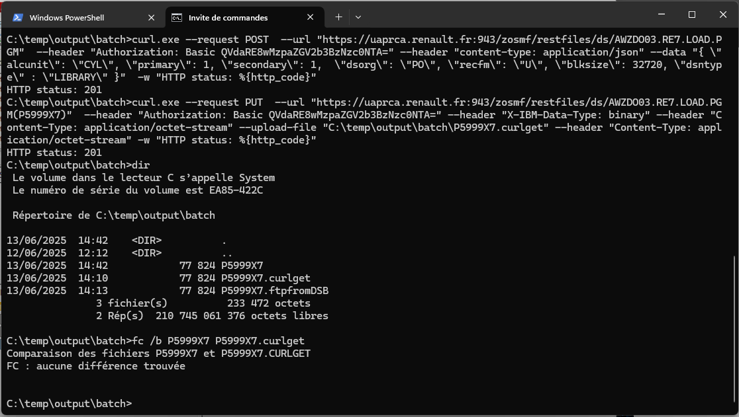
#6 – Getting transfered load with FTP
But no diff between FTP and ZOSMF get

Slide 7
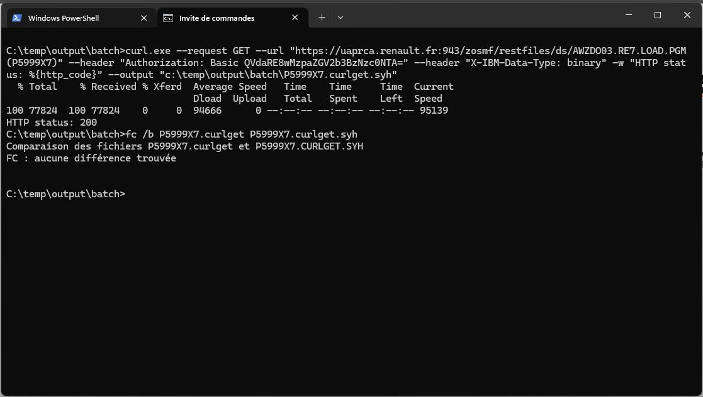
#7 – Get transfered load with zosmf rest
curl.exe --request GET --url "https://uaprca.renault.fr:943/zosmf/restfiles/ds/AWZDO03.RE7.LOAD.PGM(P5999X7)" --header "Authorization: Basic QVdaRE8wMzpaZGV2b3BzNzc0NTA=" --header "X-IBM-Data-Type: binary" -w "HTTP status: %{http_code}" --output "c:\temp\output\batch\P5999X7.curlget.syh"
But no diff between orginal and ZOSMF get

